Slide 1



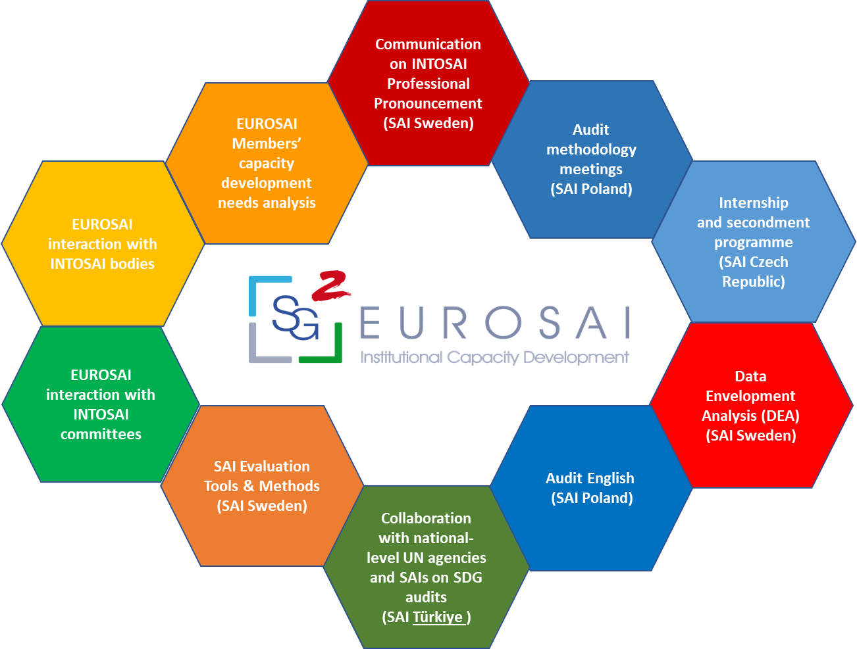
EUROSAI Strategic Goal 2
Institutional Capacity Development
58th EUROSAI Governing Board
Vilnius, 14-15 June 2023
Kamila Żyndul, Supreme Audit Office of Poland (NIK)
Peter Danielsson, Swedish National Audit Office (Riksrevisionen)

Slide 2





Strategic Goal 2 (SG2)
Support and facilitate institutional capacity development
22 projects in the operational plan
10 projects
  ITWG (EST)
  WG on the Audit of Funds Allocated to Disasters and Catastrophes (UKR)
2 Russian projects on-hold
10 projects ongoing ….

Slide 3
Progress in SG2
10 ongoing:
3 activities continuously
3 projects since 2017
  Communication on IFPP
  Audit methodology meeting
  Secondment programme
4 projects since 2022
Communication on INTOSAI Professional Pronouncement
(SAI Sweden)
Data Envelopment Analysis (DEA) (SAI Sweden)
EUROSAI
Members’ capacity
development
needs analysis
Audit methodology meetings
(SAI Poland)
EUROSAI interaction with INTOSAI committees
Audit English
(SAI Poland)
EUROSAI interaction with INTOSAI bodies
Secondment programme
(SAI Czech Republic)
Collaboration national-level UN agencies and SAIs on SDG audits
(SAI Türkiye)
SAI Evaluation Tools & Methods (SAI Sweden)

Slide 4
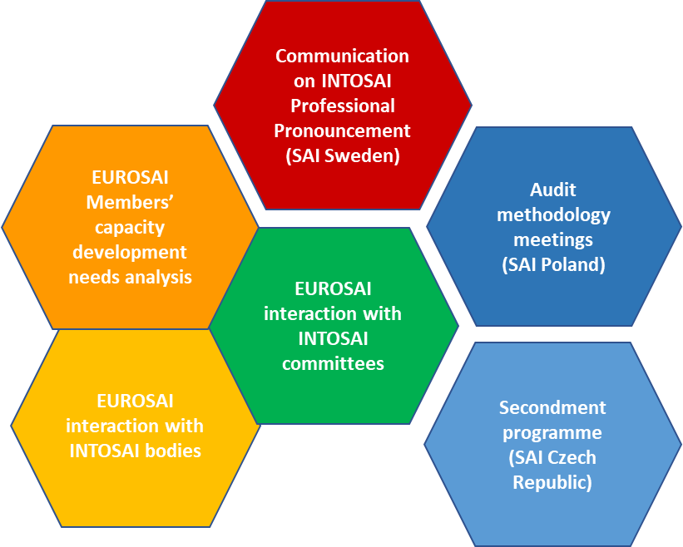
New SG2 projects since 2022
Data Envelopment Analysis (DEA)
  Kick-off April-22
  2nd-3rd DEA-WS Prague Nov-22 and Madrid Feb-23
  4th meeting (virtual) 12 Sep-23
  5th WS (IRL) 11-12 Dec-23
Audit English
  Terminology & Plain English
  Kick-off June-22
  2-3rd WS on FA and writing good English
  WS 2nd half 2023
Collaboration with national-level UN agencies & SAIs on SDG audits (SAI Türkiye)
  Closed Q2 2023
SAI Evaluation Tools & Methods
  Delayed until 2nd half 2023
Data Envelopment Analysis (DEA) (SAI Sweden)
Audit English
(SAI Poland)
Collaboration with national-level UN agencies and SAIs on SDG audits
(SAI Türkiye)
SAI Evaluation Tools & Methods (SAI Sweden)

Slide 5
The road to Jerusalem 2024
2024…
Audit English
-
WS
2nd half 2023
2nd Audit Method-ology meeting
-
15-16 NOV 2023
(IRL)
DEA & other BM-methods
-
Network 12 SEP (virtual)
5th WS 11-12 DEC (IRL)
Secondment Programme
(SAI CZ)
-
2023
XII EUROSAI CONGRESS
in Jerusalem
MAY
2024
Collab. National UN- agencies and
SAIs on SDG audits
(SAI TUR)
-
Closed
SAI Evaluat. Tools & Methods
-
Q4 2023
(External phase)
2023
2024…

Slide 6
Thank you for your attention!
EUROSAI SG2
Kamila Żyndul, Supreme Audit Office of Poland (NIK)
Peter Danielsson, Swedish National Audit Office (Riksrevisionen)

